Slide 1
BVI’s FinTech
Regulatory Sandbox
Presenter: Kishelle Blaize-Cameron

Slide 2
Objectives of the Sandbox
Promote efficiencies by encouraging new solutions;
Leverage existing or new technology in an innovative way in order to deliver new financial products or services or to improve business processes;
Provide regulatory clarity on whether a new financial product or service complies with legal and regulatory requirements; and
Develop targeted regulatory response.

Slide 3
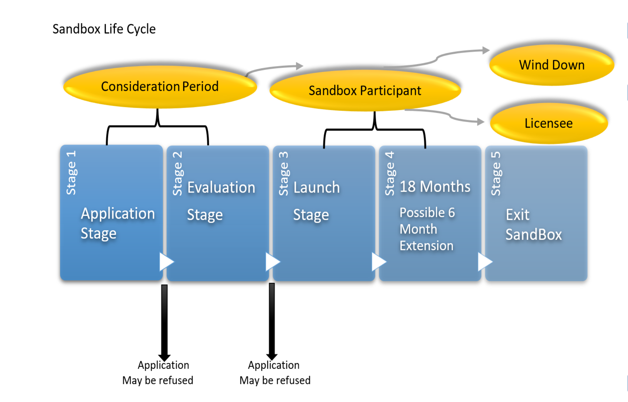
Sandbox Life Cycle

Slide 4
Application - Eligibility
Eligible persons
  A startup proposing a new financial services solution, that involves a FinTech business model that is not currently covered (whether explicitly or implicitly) under current Regulatory Legislation and may require issuance of new regulations;
  A startup who wishes to test an innovative technology to deliver a licensable financial service;
  Current licensees who wish to test an innovate technology as a part of their already approved financial service offering;

Slide 5
Application- Eligibility
Testing Categories
Proposed Niche | Description | Testing Categories
FinTech Credit Services | All credit activity facilitated by electronic platform whereby borrowers are matched directly with lenders. Automated lending process. | Peer to Peer Lending Online Lending using own capital
Payments | Systems used to settle financial transactions through the transfer of monetary value | Cryptocurrency E-Wallets Merchant Payments & PoS Services International Remittance Mobile Payments
Investment Management: | Use of big data, AI and Machine Learning to evaluate investment opportunities. | Robo Advisors Micro- investing platforms
Securities | Exchanges for the trading of cryptocurrencies | Cryptocurrency exchange
Insure Tech: | AI used to better determine risk and provide a policy more suited to the insured. | Insurance Aggregators

Slide 6
Application- Eligibility
Non-Eligible Persons
  Entities that fall outside the risk tolerance of the Sandbox due to nature, size and complexity; and
  Business Proposals that are not sufficiently developed and ready to be launched.

Slide 7
Application-Evaluation Stage
Applications will be evaluated on the following 4 key criteria;
Business Proposal and Risk;
  Target Client Base
  Financials
  Technological Architecture
  Renumeration Structure
  Customer Redress Mechanism
  Risk and Risk Management
Resources;
  Human
  Technological
  Financial

Slide 8
Application-Evaluation Stage
Applications will be evaluated on the following key criteria;
Readiness for Testing; and
  Stage of development of business model
Exit Plans
  Wind Down
  Full Deployment

Slide 9
Application-Evaluation Stage
Risk Classification
Standard | Moderately Complex | Complex
has a physical presence in the Virgin Islands; Has not commenced business; Has less than 50 retail customers; and Customer assets of less than USD5 Million. | Does not have a physical presence in the Virgin Islands; Entity has less than 2 years of operation; Has between 50 and 100 retail customers; No more than $50 million in customer assets; and Applying new technology to a financial services product or service already under remit of current regulatory legislation. | Does not have a physical presence in the Virgin Islands; Has more than 100 retail customers; Has more than USD50 million in customer assets; and Offering a new financial service or product which requires new regulation.

Slide 10
Application-Evaluation Stage
Testing Parameters
Exposure Restrictions (e.g. Number of clients, maximum AUM, etc.)
System Audit Report requirements
Financial Requirements
AML/ CFT additional measures
Required Disclosures

Slide 11
Launch Stage
90 days from the date of approval to launch
If participant has not launched, authorization will automatically be withdrawn
No extensions

Slide 12
Sandbox Participant Stage
18 months testing period
Possible 6 month extension
Comply with ongoing obligations
  Requirement to have at least 2 directors
  Compliance with AML Regime
  Compliance with Sandbox Parameters

Slide 13
Exiting the Sandbox- Key Points
Exiting the Sandbox is a key component of the Sandbox lifecycle, and may occur in the following ways:
  The Sandbox Participant has arrived at the end of its sandbox duration;
    May Wind down
    May transition to full licence
    Required to Wind down
  The business model must be discontinued whether at the initiative of the Sandbox Participant or the Commission; or
  The Sandbox Participant has failed to launch (within the prescribed launch period).

Slide 14
Fees
Business Model Type | Application Fees | Approval Fee
Standard/ Non Complex | $2000 | $2000
Moderately Complex | $2000 | $5000
Complex | $2000 | $10 000

Slide 15
Proposed Sandbox Launch Date
August 31, 2020
Notes:
15 October, 2019

Slide 16
Contact Information
Please send emails to sandbox@bvifsc.vg

