Slide 1
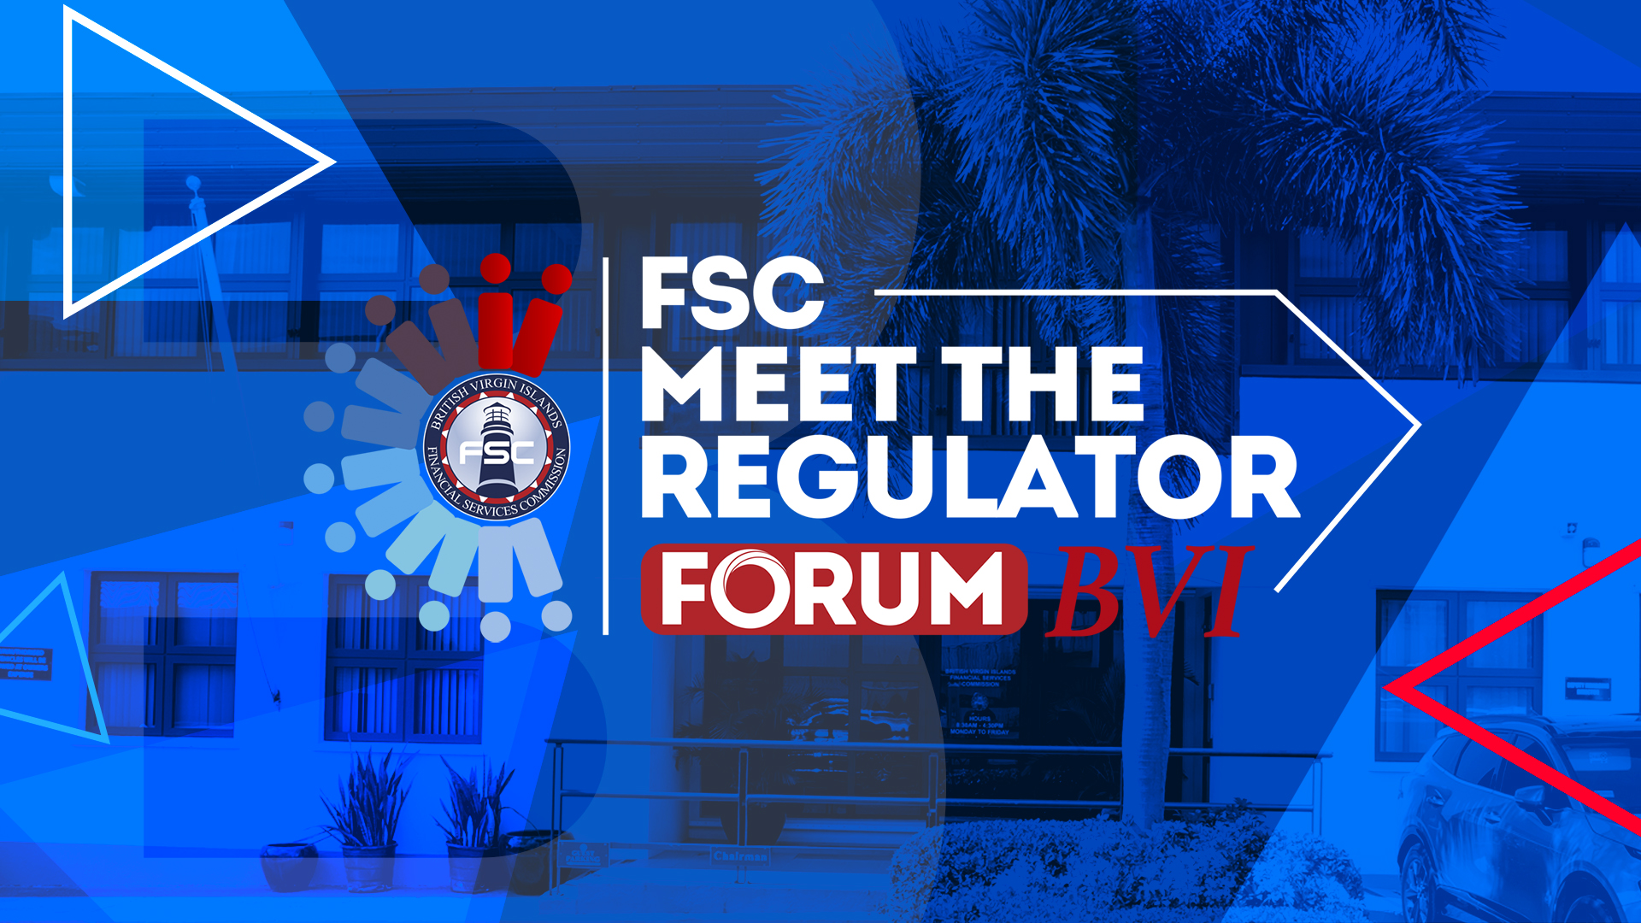



Slide 2

TOPIC: Access to Beneficial
Ownership Information

Slide 3
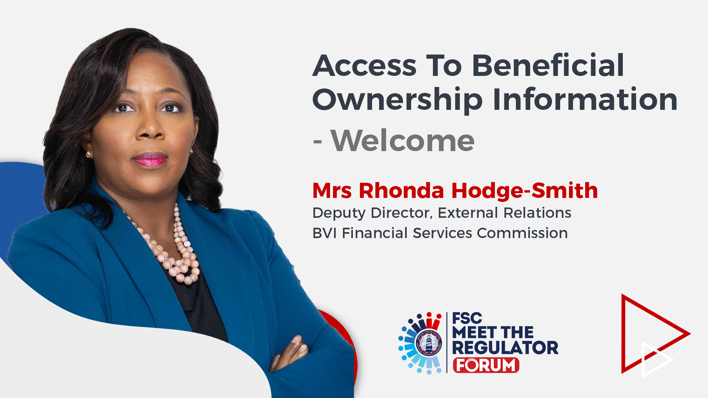

Slide 4
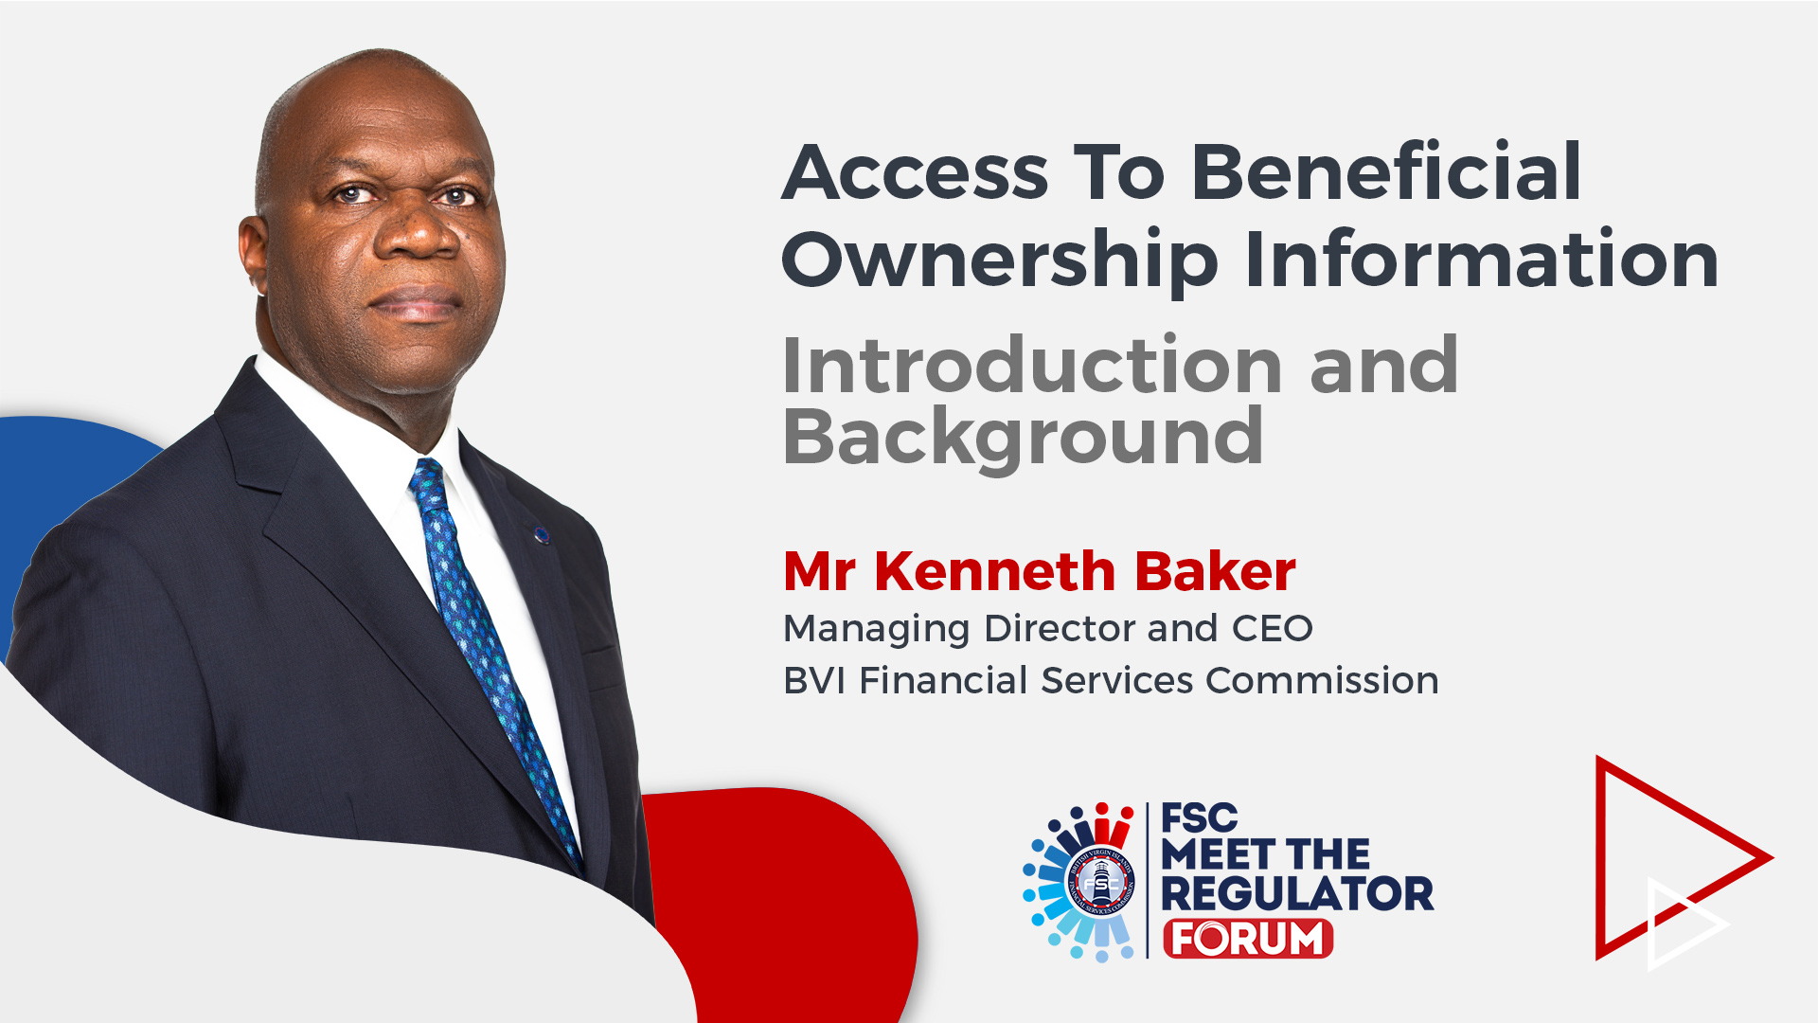

Slide 5
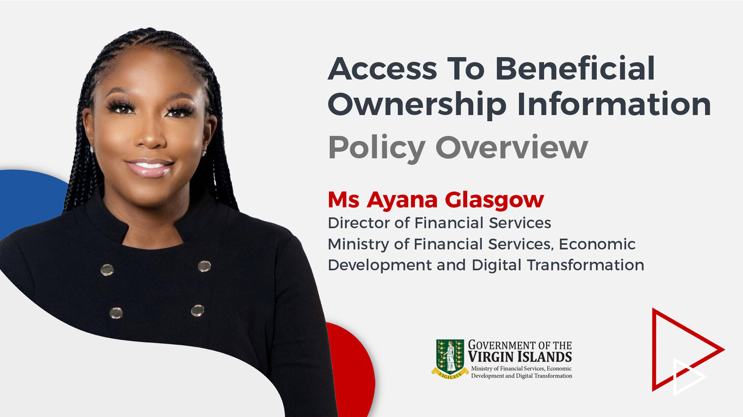

Slide 6
International Developments on BO Transparency
Stakeholder Consultation
Final Policy on Access to BO Information

Slide 7
ORIGIN AND TIMELINE OF PARBOs

Slide 8
INTERNATIONAL DEVELOPMENTS ON
BENEFICIAL OWNERSHIP TRANSPARENCY
Financial Action Task Force (FATF) Rec 24
  Standard vs. 2023 Guidance
EU AML Directive 6
  Access under Legitimate Interest

Slide 9
STAKEHOLDER CONSULTATION

Slide 10
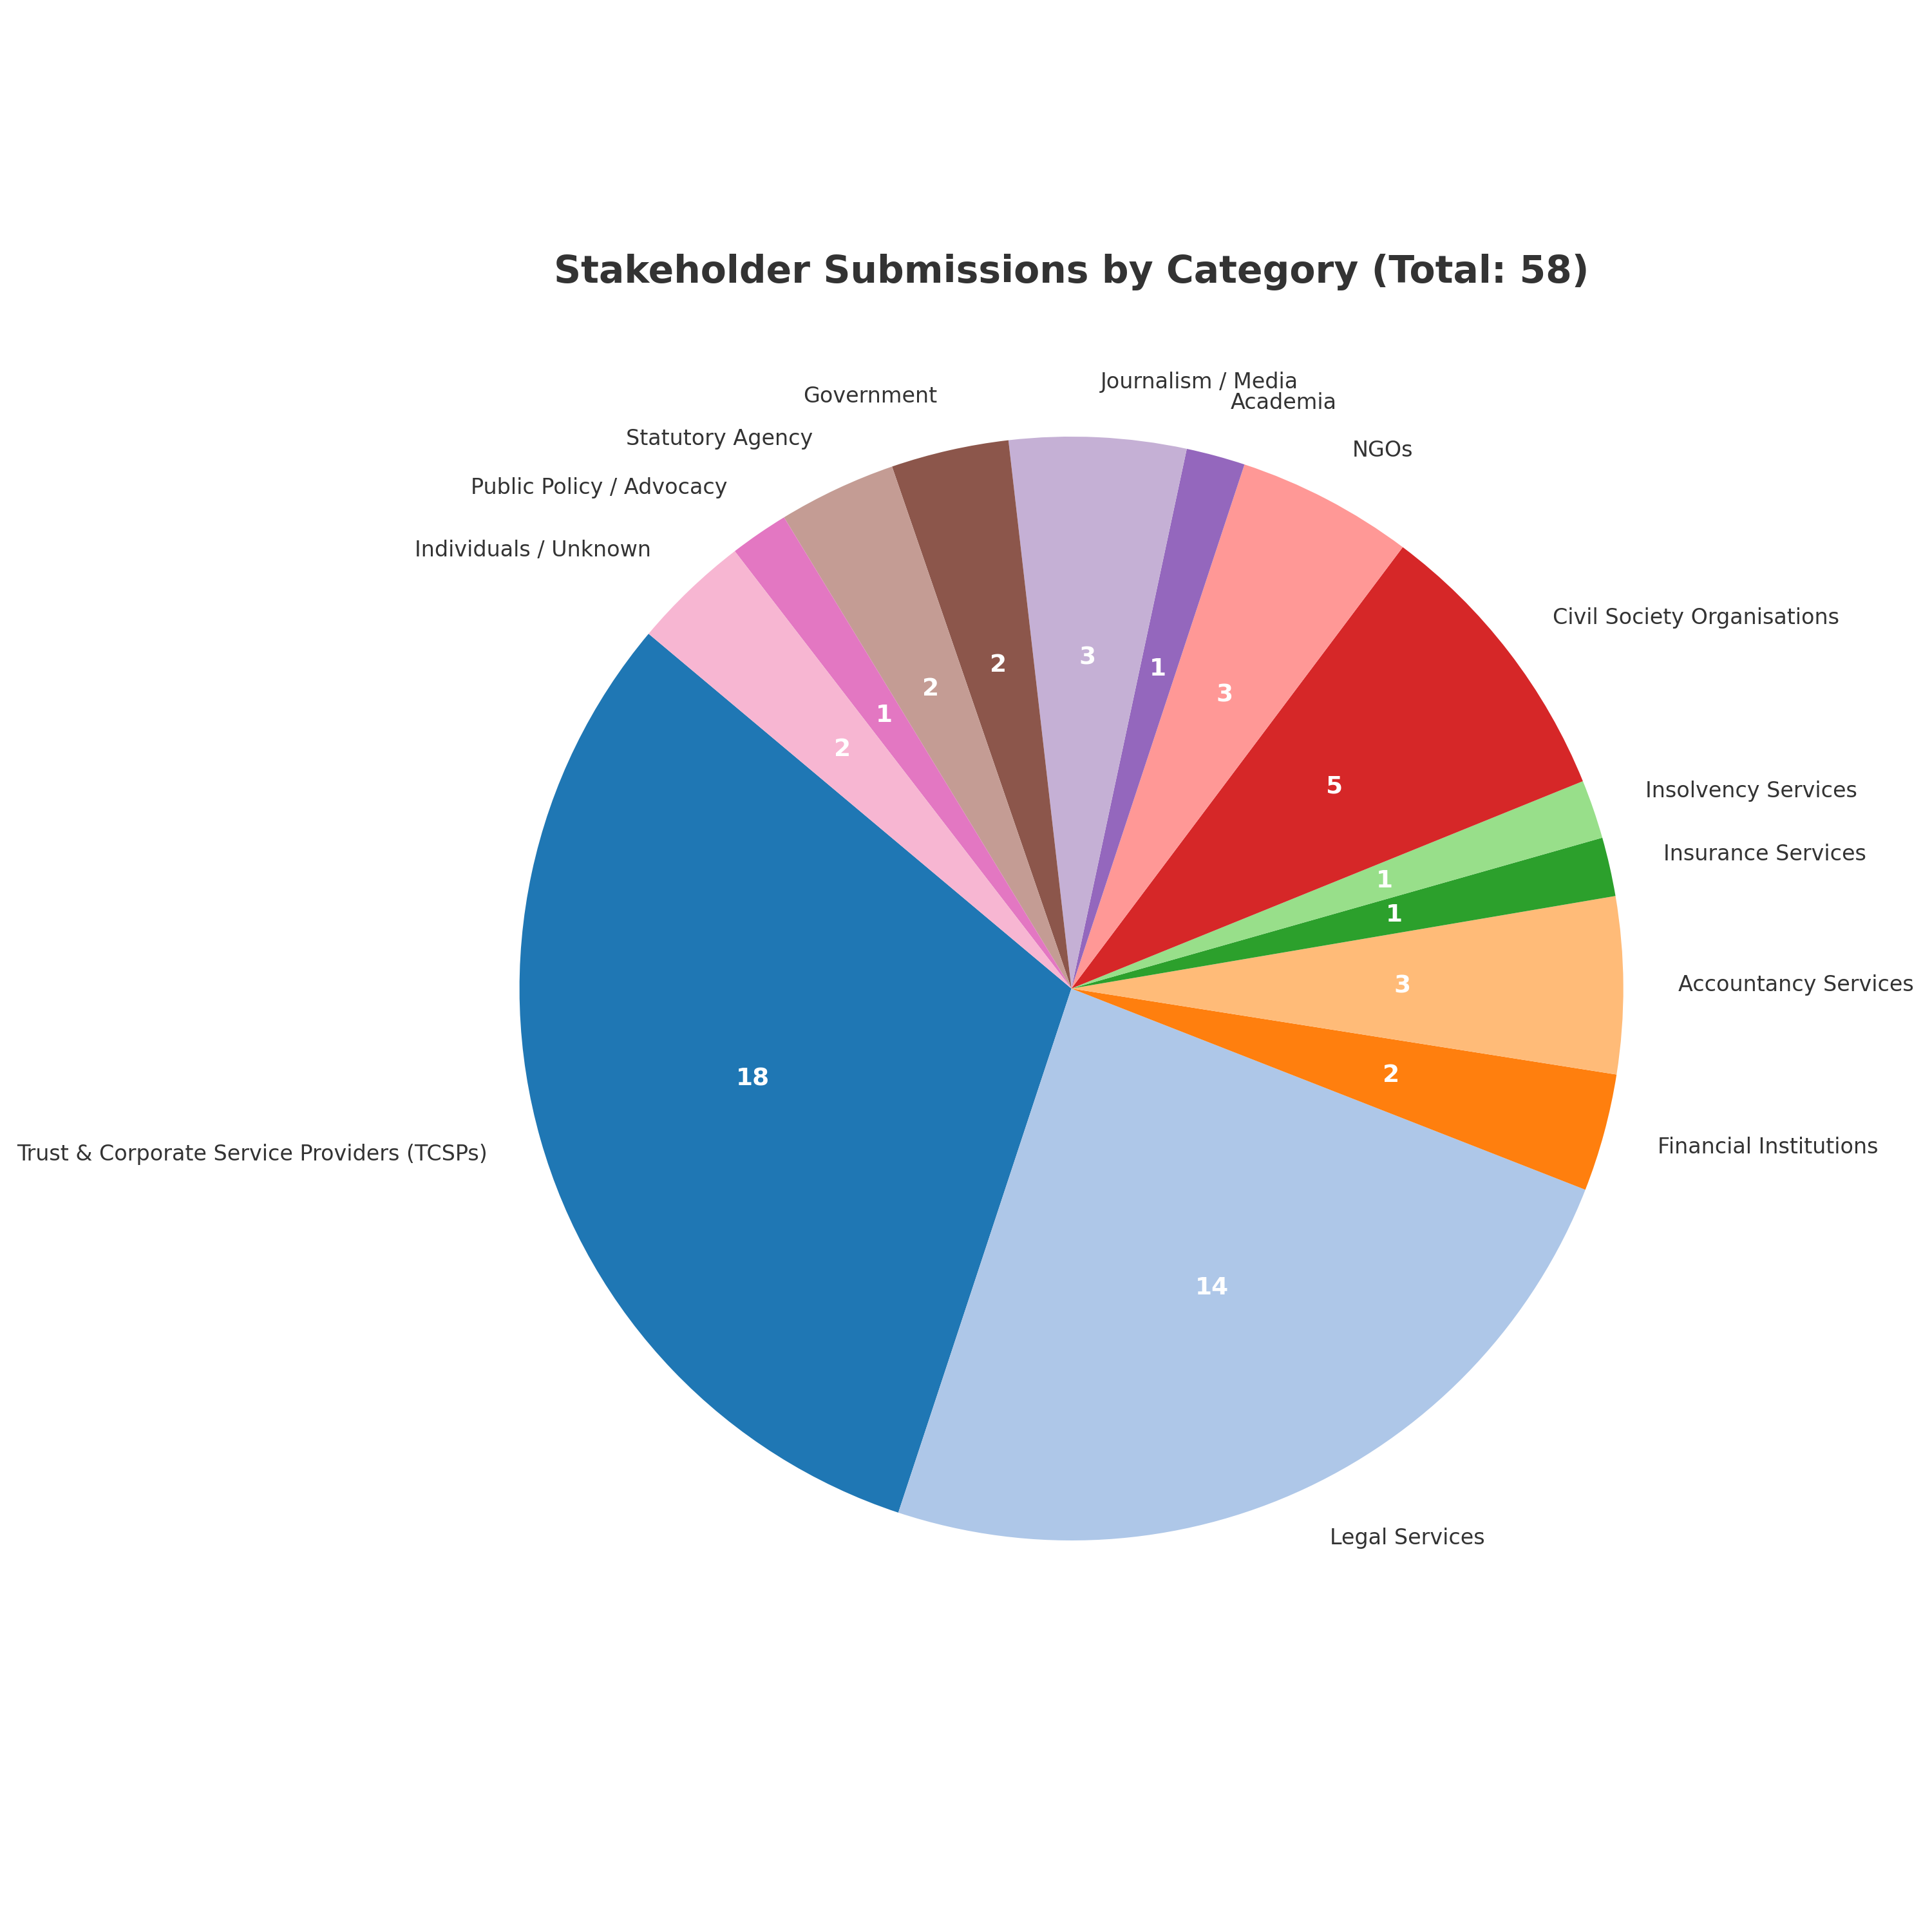
STAKEHOLDER SUBMISSIONS BY CATEGORY (TOTAL: 58)
Notes:
@Trevon Lewis can you fix this to look better

Slide 11
KEY CROSS CUTTING ISSUES
Widespread concern about access by media, NGOs, and academics due to potential for misuse and lack of regulation.
Objection period (5 business days) widely viewed as too short; proposals ranged from 10 to 21 days.
Broad support for expanded exemptions, especially for minors, persons in high-risk jurisdictions, and those under threat.
Strong emphasis on privacy safeguards, data protection, and clear guidance from the Registrar.
Repeated suggestions to use existing systems (e.g., BOSS) and ensure operational readiness before launch.

Slide 12
POLICY ON RIGHTS OF ACCESS
TO BO INFORMATION

Slide 13
SCOPE OF ACCESS
Limited Scope of Access
Applies to individuals/entities demonstrating legitimate interest for AML/CFT/CPF purposes:
  Investigation or detection of ML/TF/PF activity.
  Customer due diligence by obliged entities.
  Links to convicted persons or criminal proceedings involving ML/TF/PF.
Access limited to BOs with 25% or more ownership/control.

Slide 14
ACCESS PROCEDURE
BO Information access through VIRRGIN to the Registrar.
Only specific information is disclosable.
Timely access to the information - 12 days
Fees are payable.
Due process required (Notification and Objection)
  Notification to Legal Entity
  BO/Legal Entity can raise objections
  Registrar assess/determines merit of objections
  Suspension of disclosure during objection or appeals process
Notes:
Access procedure will be addressed in more details by my colleagues in legal and operational sections of this presentation, but in the main it has been determined that
Access through requests via VIRRGIN
Disclosable information ncludes entity name, purpose, and BO details (only if known).
Registrar to decide within 12 business days.
Request fee: USD $75 (non-refundable).
Notification to legal entity via registered agent when access request is received.
5 business days to object based on specific grounds (e.g., disproportionate or other serious risk, minors, national security).
Registrar reviews objections and decides whether to uphold or reject.
Disclosure suspended to the requesting person or entity during objection period or appeal.

Slide 15
EXEMPTIONS FOR BENEFICIAL OWNERS
Beneficial owners may apply for exemption at any time.
Exemption applications must be handled before dealing with application to inspect register – 12 days.
Very specific grounds for exemption, includes disproportionate risk, legal incapacity, national security, or public interest.
Fees Payable
Notes:
Exemption to be filed anytime
Applications reviewed by Registrar within 12 business days.
Exemption fee: USD $50.

Slide 16
INFORMATION DISCLOSED UPON ACCESS
Limited information disclosed upon access.
  Full Name of Beneficial Owner
  Month and Year of Birth
  Nationality
  Nature and Extent of Interest (25% + ownership/control)
Notes:
Full Name of Beneficial Owner
Month and Year of Birth
Nationality
Nature and Extent of Interest (25% + ownership/control)

Slide 17
SAFEGUARDS AND PENALTIES
Strict confidentiality and data protection under Data Protection Act, 2021.
Access misuse may result in fines, bans, legal action.
Audit trail maintained by Registrar.
Discrepancies must be reported by obliged entities within 14 business days.

Slide 18
ENTRY INTO FORCE
Transitional period: 1 July 2025 to 31 March 2026
Activities during this period:
System enhancements
User testing and training
Public guidance and exemption processing
Full regime operational: 1 April 2026

Slide 19
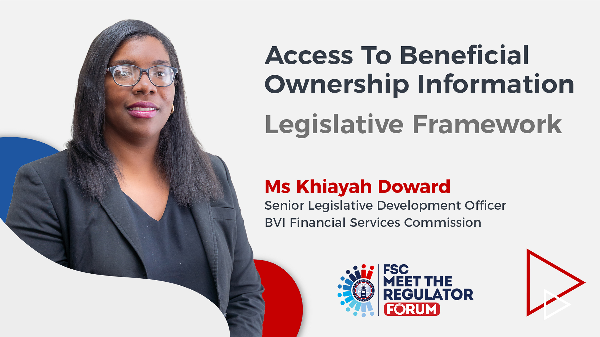

Slide 20
Amendments to the
BVI Business Companies and Limited Partnerships (Beneficial Ownership) Regulations

Slide 21
THE REGULATIONS
Overview of Key Amendments
Exemptions
Notices under regulation 18 (Duty to Investigate)
  New obligation for legal entities
Restrictions on beneficial owner’s interest
Access to the Register of Beneficial Ownership
  Legitimate Interest
  Key provisions on Access to BO information
Notes:
You just heard from Ms. Glasgow on the Territory’s Policy on Rights of Access to BO information.
My presentation will first set out some key new exemptions relative to the filing of BO information
It will also clarify certain obligation for legal entities and explain the introduction of restrictions on BO interest.
My presentation will then focus on how that Rights of Access Policy cascades down through the Regulations.
As such I will explain some of the the key provisions in the amendment regulations.
I will set out how we define who has Legitimate Interest and can therefore request the information
I will also discuss briefly a number of key provisions relative to access to BO information.
Finally I will round up with the time frame and transition period for compliance with the amended regulations.

Slide 22
EXEMPTIONS (Filings)
Existing Exemptions | New Exemptions
Specified fund | Legal entity that is a subsidiary of a fund*
Listed company | BC that is a subsidiary of listed company
BC whose shares are held by a BTCA trustee | BC whose shares are held by foreign regulated trustee
Legal entity that is a subsidiary of another legal entity subject to the requirements of the BO Regulations | State owned entities
Legal entity subject to disclosure and transparency rules contained in international standards equivalent to those applicable to funds and listed entities
Notes:
Section 96(A) of the BC Act and Section 53(B)(3), together with Section 11 (1) (c) of the Regulations, set out the available for exemptions.
Following the implementation of the BO Regime, our industry partners identified that there may be additional exemptions that are necessary.
To be clear the word exemption may be a misnomer, it doesn’t absolve you from filing anything at all. What it does is require you to file an exemption filing specifying which exemption you meet. My colleague will discuss how the current exemption filing works and how the new ones will apply.
In any event, 5 new exemptions are introduced with these amendments, some of which mirror existing exemptions. For example,
Subsidiaries of Funds are specified now exempted
So are subsidiaries of listed companies, and
BCs whose shares are held by Foreign Regulted Trustees.
State Owned Enterprises
International Organisations (Explain)

Slide 23
NOTICES (UNDER REG 18)
No requirement (for legal entity) to send regulation 18 Notice where required BO information is filed
  on incorporation, registration or continuation;
  within other period specified in BO Regulations; or
  Legal entity has otherwise identified the BO and has no cause to believe that the person is no longer its BO.
New obligation for legal entity:
  Notify Registrar where notice sent and:
    no response received; or
    where a response has been received, the response does not confirm identity of the beneficial owner
Notes:
Section 18 of the Regulations set out the obligations for Legal Entities to issues notices to confirm BO information and particulars
Section 18 has been further amended to clarify that a person who receives notice is not required to disclose the information if they are legally prohibited from disclosing the information.
Section 18 has also been amended to make it clear that if they legal entity had already provided the information on incorporation or has no cause to believe that BO is no longer a BO, then it under no obligation to issue notice.
Section 18 has also been amended to make it clear that if the legal entity has taken all necessary steps to ascertain the BO, but has not received a response or the response didn’t confirm the identity of the BO, then the LE has not contravened the law.
But in that circumstance the Legal Entity is would have had to notify the Registrar within 21 days of the period of compliance which is 30days for new entities.

Slide 24
RESTRICTION ON BENEFICIAL OWNER'S INTEREST
Regulation 18 legal entity notification to the Registrar
  Steps taken to identify BO
  No response to legal entity notice to BO
  Response received fails to confirm BO Identity
Registrar serves restriction notice on legal entity
  Registrar to make decision having regards to effect of the notice
  Restriction Notice (what does it do?)
    Restricts rights or transactions of the BO’s relevant interest
  Withdrawal of restriction notice by Registrar
  Removal of the restriction notice by the High Court
Notes:
Where a legal entity notifies the Registrar as required under regulation 18, Registrar required to issue a notice restriction rights or transactions in the beneficial owner’s relevant interest, including transferring the interest and rights exercisable in respect of the relevant interest
Removal of restriction notice may occur as follows:
Registrar withdraws the restriction notice in prescribed circumstances
Satisfied that the BO has been identified
Rights of 3rd Parties are unfairly affected
Valid reason (death) for failure to identify the BO
Legal entity or other person aggrieved by the restriction notice applies to the court to set aside the restrictions notice
Courts have a number of remedies available to it and can issue orders specifying certain things

Slide 25
RIGHTS OF ACCESS TO INFORMATION IN THE BENEFICIAL OWNERSHIP REGISTER
Competent authorities
Law enforcement agencies
Parties to the Exchange of Notes between BVI Government and UK Government
Persons with a legitimate interest
Notes:
Recall that the existing BO regime allows access to beneficial ownership information by:
Parties to the Competent authorities
Law enforcement agencies
e Exchange of Notes between BVIG and UK Government
To give effect to the policy that Ayana discussed extensively at the beginning, the BO regulations are being amended to allow access to a different category of persons.
These are Person’s with a legitimate interest in the information

Slide 26
ACCESS TO THE BO REGISTER
(LEGITIMATE INTEREST)
Restricted Register (legitimate interest)
Definition for legitimate interest:
  Purpose of request is to investigate, prevent or detect ML, TF or PF
  Beneficial owner of a legal entity (to which the request relates) has been convicted, or has had criminal proceedings commence for the offence of ML, TF or PF
  “obliged entity” carrying out CDD or other obligations in accordance with VI’s AML laws
Notes:
It is important to reiterate that access to BO information remains RESTRICTED to persons specified in the previous slide.
In turn, Legitimate interest is narrowly defined to encompass 3 scenarios:
1) Persons who can demonstrate that the purpose of the request is to investigate, prevent or detect ML, TF, PF activity.
2) Persons who can demonstrate that the BO is involved in criminal activity related to ML,TF or PF. That they were convicted or has criminal proceedings for the offence of ML,TF, or PF.
3) Obliged entities carry out CDD of BVI AML Obligations
Explain who is an “obliged entity” are entities that have CDD or AML Obligations under BVI Law.
Here we are ensuring that obliged entities like TCSPs has a smooth pathway and efficient pathway for carrying out their responsibilities.

Slide 27
ACCESS TO THE BO REGISTER
Access restricted to information for BOs holding 25% or more interest
Positive demonstration of meeting the legitimate interest test allows access to information contained in the BO Register
Access restricted to specified BO information
  Name
  Month and year of birth
  Nationality
  Nature of interest/control over entity

Slide 28
NOTIFICATIONS, OBJECTIONS AND DISCREPANCY REPORTING
Notifications - Registrar
Objections - Legal entity
Discrepancy Reporting - Competent authorities, law enforcement agencies and obliged entities
Notes:
The draft Regulations includes details on the process and access procedures and that will be covered in detail in the next presentation.
However, I want to focus on the notification requirement that forms part of the process. Where a request for access to BO information has been made, the Registrar will have an obligation to notify the legal entity of the request through its registered agent.
Legal entity will have an opportunity to object the disclosure of the BO information. The timeframe and process for doing so are to be set out in the amendment legislation, with additional details to be provided for in guidance, as required. Where the Registrar rejects an objection, the legal entity may appeal to the Financial Services Appeal Board in accordance with the provisions of the Financial Services Appeal Board Act.
Requirement for competent authorities, law enforcement agencies and obliged entities
Notify Registrar in writing of any discrepancy discovered re. beneficial ownership information within 14 days of discovery

Slide 29
EXEMPTION FROM DISCLOSURE OF
BENEFICIAL OWNERSHIP INFORMATION
“A person may at any time apply to the Registrar in the approved form seeking an exemption from the disclosure of BO information.”
This can only be done under specific circumstances:
  Fraud, kidnapping, blackmail, extortion, harassment, violence, intimidation or other similar harm
  BO information relate to child or individual who lacks legal capacity
  Other special reason(s)
  National security issues
  Public interest grounds
Notes:
The Policy recognizes that there may be circumstances where BO information should not be disclosable.
As such the regulations make provisions for persons to apply for an exemption from the disclosure of their BO information in very specific circumstances.
Regulation 31(G)

Slide 30
PROHIBITIONS
Knowingly or recklessly making (in the request) a statement that is misleading, false or deceptive in a material particular
Doing anything, or failing to do anything, resulting in BO information being disclosed to another person
Using information received for a purpose other than the purpose for which it was requested
Notes:
There are some significant prohibitions on what can be done with the information or how the information should be treated.
These are set out in Regulations 31H

Slide 31
FEES AND PENALTIES
Fees to be set out in Schedule 1 of the BVI Business Companies Act.
Penalties for misuse or non-compliance to be set out in Schedule 3 of the BO Regulations
Penalties include being listed as a restricted person.
  Cannot make further requests for access to BO information
Notes:
Any contravention may result in a penalty or being placed on a list of restricted persons who cannot make a request for access to BO information

Slide 32
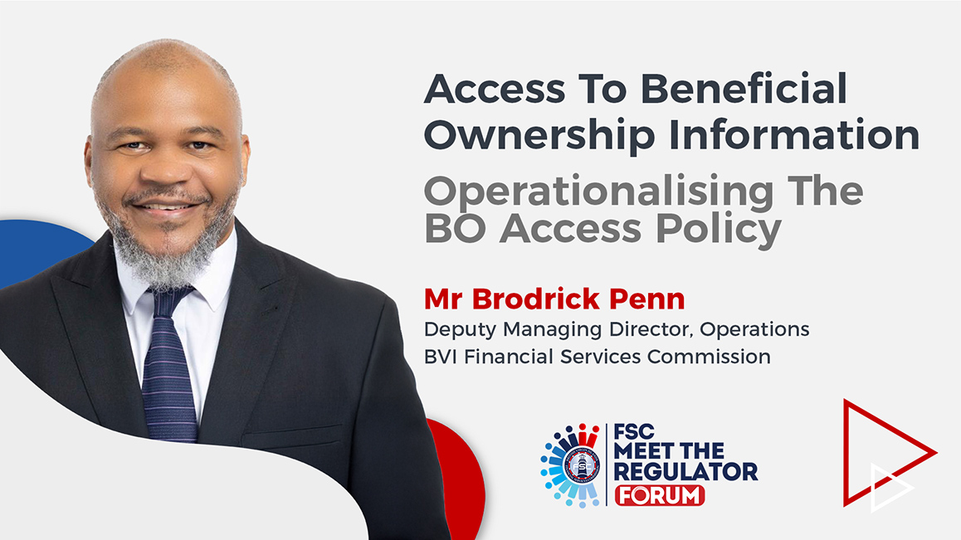

Slide 33
BACKGROUND - SYSTEM DEVELOPMENT
Corporate system built on our flagship platform.
2024- 2025 system development to facilitate BC/LP changes including Beneficial Ownership requirements.
Industry familiarity with ‘front end’ UI/UX.
Several BO transactions were deployed into production, including registration and exemption filings.
Anticipate significant increase as time progresses, accelerated by bulk filing transaction.

Slide 34
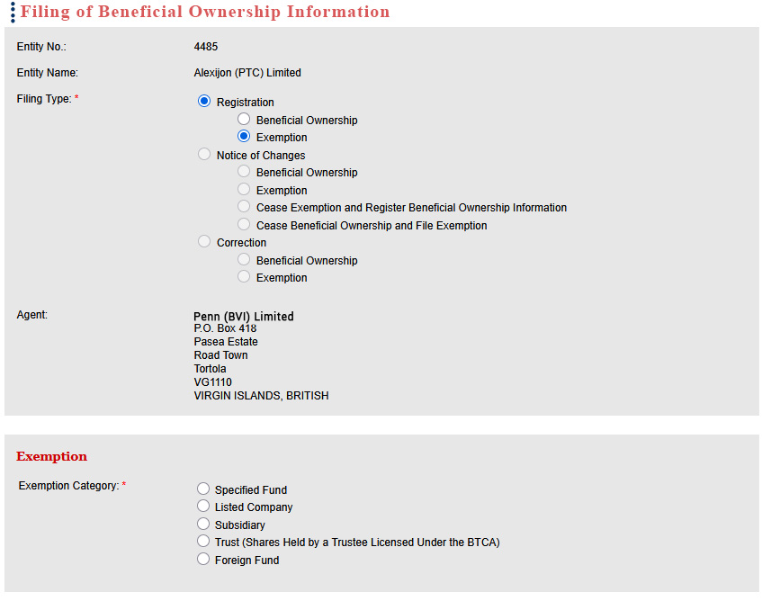
EXEMPTION TRANSACTIONS IN PRACTICE
Notes:
Colleague spoke about the existing exemption and also detailed the new exemptions.
5 new exemptions are introduced with these amendments, some of which mirror existing exemptions. For example,
Subsidiaries of Funds are specified now exempted
So are subsidiaries of listed companies, and
BCs whose shares are held by Foreign Regulted Trustees.
State Owned Enterprises
International Organisations

Slide 35
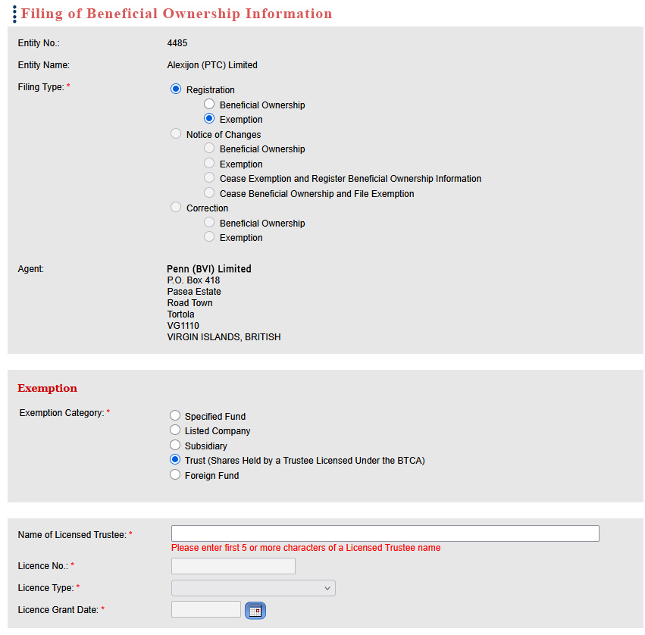

Slide 36
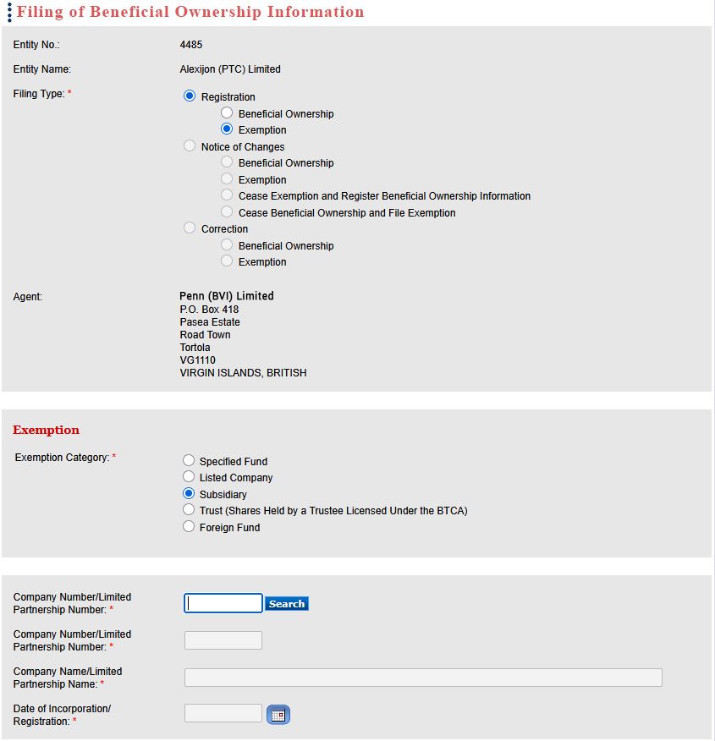
Notes:
So effectively, when the new transactions are deployed, you will see and option under the exemption category which now includes those new exemptions of;
Subsidiaries of Funds are specified now exempted
Subsidiaries of listed companies, and
BCs whose shares are held by Foreign Regulted Trustees.
State Owned Enterprises
International Organisations

Slide 37
RESTRICTION ON BENEFICIAL OWNER'S INTEREST
Legal entity notifies Registrar of no response to notice, or failure to identify BO in response to, a notice (under reg. 18)
Registrar serves a “Restriction Notice”, restricting rights of relevant interest, automatically sent via VIRRGIN
Registrar withdraws notice if conditions have been satisfied.
Notes:
You would have heard my colleague explain the concept of restriction on Beneficial Ownnership Interest
I am going to explain how we envision it to happen procedurally.
Firstly, the Registrar will first have to be notified by the Legal Entity through RA that they had no response to their own notice to identify the BO or that they failure to identify BO.
We anticipate that this will happen through VIRRGIN
In turn the Registrar is obligated to serve a “Restriction Notice”, restricting rights of relevant interest.
Before deciding, Registrar has to have regard to the effect it would have on the persons rights.
This notice will automatically be sent via VIRRGIN
The notice will specify that the BOs relevant interest is restricted in accordance with 18)(A)(3).
The Restriction notice will also set out the Effect of the Notice:
- 18(b) Language
- Void transfers or agreement to transfers
- No rights are exercisable
- No relevant interest issued
Company will be flagged in VIRRGIN that company has BO with relevant interest that is restricted
Registrar could withdraw notice if satisfied any condition in 18(a)(4) are met
- BO Identified
- 3rd Party Rights Unfairly affected
- Valid Reason or justification e.g. death of BO

Slide 38
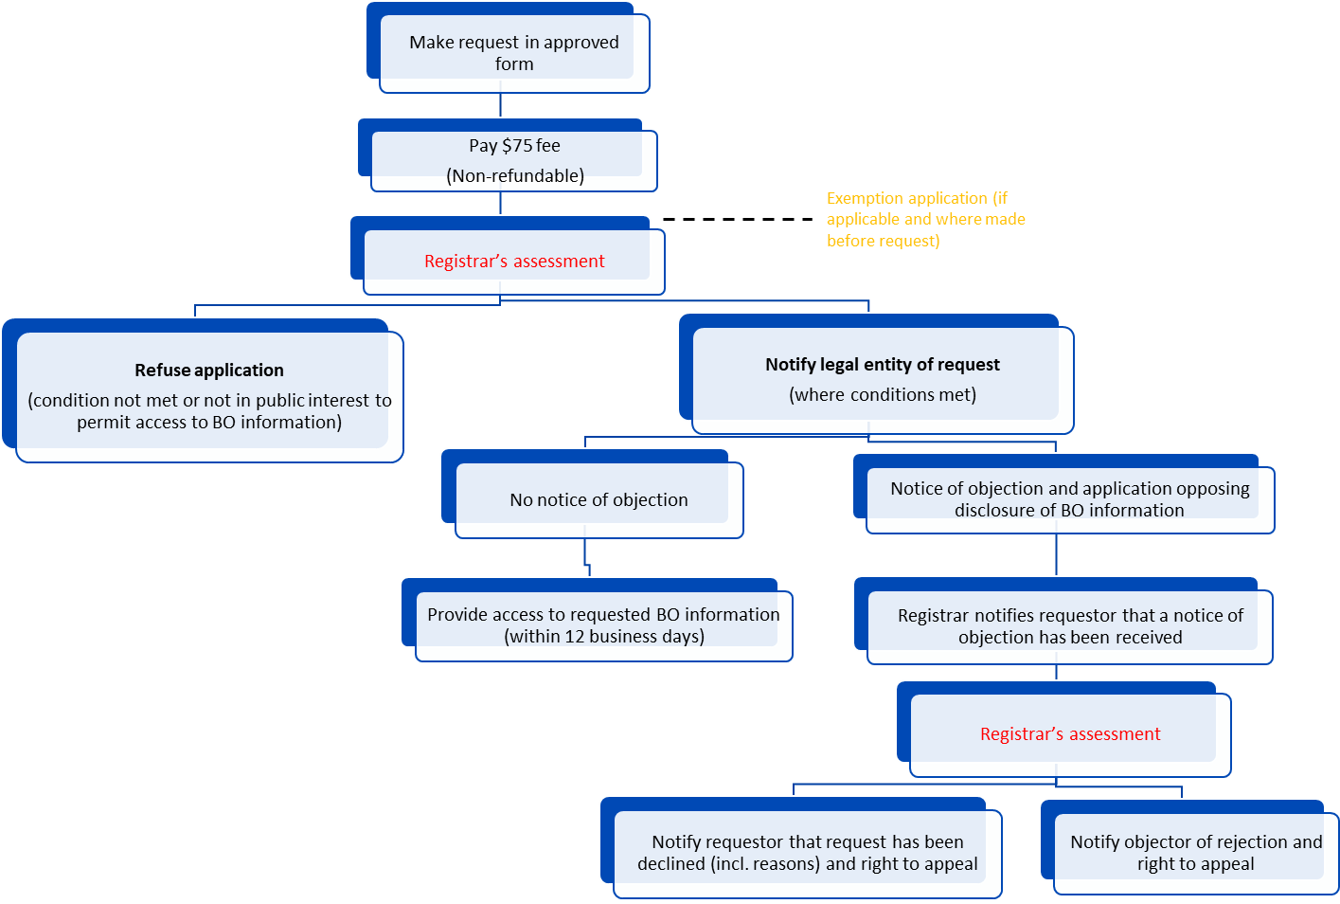
PROCESS RE: REQUEST ACCESS TO BO INFORMATION
(BASED ON A LEGITIMATE ACCESS)
Notes:
Make a Request in the Approved Form
The user will submit a Request to the Registrar via a Search/Request for BO Information function
Together with the non-refundable fee (Payment Portal)
The system automatically routes the request to the Registrar
The Registrar makes an assessment
Conditions for inspection
The Registrar’s Assessment involves reviewing that the relevant information is submitted
The submission must contain specified information
The next 3 Slides details this information

Slide 39
APPLICATION INFORMATION - INDIVIDUALS
Name
Address and contact details
Statement of purpose for which requested BO information will be used
Name of BVI legal entity to which the request relates
Name of beneficial owner (if known)
Declaration that beneficial ownership information requested will be used solely for the purpose outlined in the request
Any other information or document that will assist the Registrar in his/her assessment
Sign request in prescribed manner

Slide 40
APPLICATION INFORMATION – LEGAL PERSON
Name and licence/registration number of legal person
Name, address and contact details of an individual
Statement of purpose for which requested BO information will be used
Name of BVI legal entity to which the request relates
Name of beneficial owner (if known)
Declaration that beneficial ownership information requested will be used solely for the purpose outlined in the request
Any other information or document that will assist the Registrar in his/her assessment
Sign request in prescribed manner

Slide 41
APPLICATION INFORMATION – OBLIGED ENTITY
Name and address of obliged entity
Contact details of an individual
Statement that purpose of request is to assist in carrying out CDD and other obligations in accordance with AML/CTF/CPF laws
Name of BVI legal entity to which the request relates
Name of beneficial owner (if known)
Declaration that beneficial ownership information requested will be used solely for the purpose outlined in the request
Any other information or document that will assist the Registrar in his/her assessment
Sign request in prescribed manner

Slide 42
OBLIGED ENTITIES
Requirement
Notify Registrar in writing of any discrepancy
discovered regarding beneficial ownership
information within 14 days of discovery
Notes:
Obliged Entities have a special duty when they see the Register to notify of any discrepancy between the Register and any information held by it.

Slide 43

REGISTRAR’S ASSESSMENT
Has the requester demonstrated legitimate interest?
Has the required information been submitted?
Are there any exemptions applicable to the BO information?
Registrar to Refuse if :
  Conditions not met
  Public interest grounds
Rejection letter to requester
Notes:
Registrar’s Assessment
Registrar’s Assessment of the request to inspect register or obtain a copy is critical to this entire process.
Remember the request with all the particulars will be routed via VIRRGIN and our normal review process.
She must first determine if the requester demonstrated legitimate interest.
She must also determine whether the required information has been submitted (name and contact, statement of purpose of request, the legal entity, BO, Declaration)
She must also ensure that no exemptions from disclosing the information has been granted.
And she can ask for whatever other information she needs to determine the request.
If any of the conditions are not met, or the public interest grounds not to acceded the Registrar can REFUSE
If that determination is made the Registrar through VIRRGIN send a rejection letter/email.

Slide 44
REGISTRAR’S NOTIFICATION
(that Request has been made to inspect the Register)
Registrar determines that the request satisfies conditions.
The Registrar (VIRRGIN) notifies the legal entity of request, stating particulars:
  Purpose for information
  5 days to object
No notice of objection, Registrar to honour the request – 12 Days.
VIRRGIN sends specified information to the requester.
Notes:
Where the Registrar determines that the conditions are satisfied, she has an obligation to notify the Legal Entity that the request has been made.
This process/ notification happens through VIRRGIN also, so its rather seamless
The notification will specifically tell the legal entity the purpose for which the information is sought and that they have 5 days to object.
Where there has been no notice of objection the Registrar will honour the request
VIRRGIN will send the relevant BO information to the Requester. Limited to name, DOB, nationality, nature of interest

Slide 45

LEGAL ENTITY FILES NOTICE OF OBJECTION TO THE REQUEST TO INSPECT/ RECEIVE A COPY OF AN ENTRY IN BO REGISTER
Within a further 5 days – Legal Entity must provide details and show cause for Notice of Objection
Request to inspect/ receive copy of an entry in BO Register
Within 5 days – Legal Entity May
File Objection
Registrar to Notify Requestor that Notice of Objection filed
Notes:
31E
Legal entities have a right to file notice of objection for the requested information. i.e. That the Registrar should not accede to the Request for information
This is yet another process that will be facilitated through VIRRGIN, A legal entity via its RA will apply to Registrar.
Application to Registrar should outline
Certain details of BO, name and contact details
Show cause why the request shouldn’t be honoured (no proper purpose or misleading, or inaccurate information, harm, legal capacity, national security, public interest)
Other information to help Registrar’s determination
Application to be filed (within 5 days of filing the initial Notice of Objection under Reg 31D(2)(c) )
The Registrar via VIRRGIN will also notify the requestor that an objection has been made.
If the Registrar finds that the information is not for a proper purpose, Registrar declines request for information and notify the requester, stating reasons.
The Registrar will through VIRRGIN notify the Requestor.
If the Registrar finds that the request meets the requirements and is a for a proper purpose, and misleading, or inaccurate information, or harm, legal capacity, national security, public interest;
She will issue accede to the request and issue a notice to the person who objected to the information being disclosed.

Slide 46
APPEALS TO THE APPEALS BOARD UPON REJECTION OF NOTICE OF OBJECTION BY THE REGISTRAR
Appeals process available to Beneficial Owner and Requestor through the Appeals Board if aggrieved by Registrar’s Decision
Notes:
REG 31F – As Drafted:
When the Registrar rejects a notice of objection, the Legal Enity/BO has recourse; as well as the requester.
They can file an appeal within 21 days.
The appeal acts as a stay of Registrar’s Decision refusing the Objection; until the Appeals Board makes a decision
But this can only happen if the appeal is filed before Registrar Grants Request for the information.

Slide 47
APPLICATION FOR EXEMPTION FROM DISCLOSURE OF BENEFICIAL OWNERSHIP INFORMATION
Beneficial Owner submits Application through VIRRGIN to Registrar (at any time)
BO selects applicable circumstance(s) to warrant exemption from disclosure
Registrar determines application:
  A) If Exemption granted –
    i) Notice of Grant of Exemption sent to Applicant through VIRRGIN; and
    ii)Notice of Refusal sent through VIRRGIN to Requestor
    B) If Exemption refused
    i) Notice of Refusal of Exemption sent to Applicant through VIRRGIN
    ii) Requestor granted right to inspect/ receive a copy of an entry in the BO Register (if applicable)
Submit Exemption Application
Anytime
Via VIRRGIN
Application Details
Name/Contact Applicant
Circumstances
Registrar Determines
Granted Yes/No?
Name/Contact BO
Notes:
Application Details:
Applicant Name and Contact details
Name and Contact Details of BO
Applicable circumstances- Reg 31G(6)
Evidence of likely occurrence of circumstance
Any other information
Circumstances
Harm (fraud, kidnapping, blackmail, extortion, harassment, violence, intimidation) to applicant or immediate family (spouse, partner, children, parents, brothers, sisters)
Protected legal status (minor or person lacking legal capacity)
Special reason/ exceptional circumstance determined by Registrar subject to undertaking and limited for specified period
Relates to issues of National Security (requires additional evidence – official letter national authority with responsibility for security)
Public Interest (nature of request not in public interest)
Determination
Where exemption granted may be General or Specific
May be determined by reference to the Commission for an assessment of circumstances and assessment relied upon by Registrar in making decision
BO Required to advise Registrar if circumstances change or are less likely

Slide 48
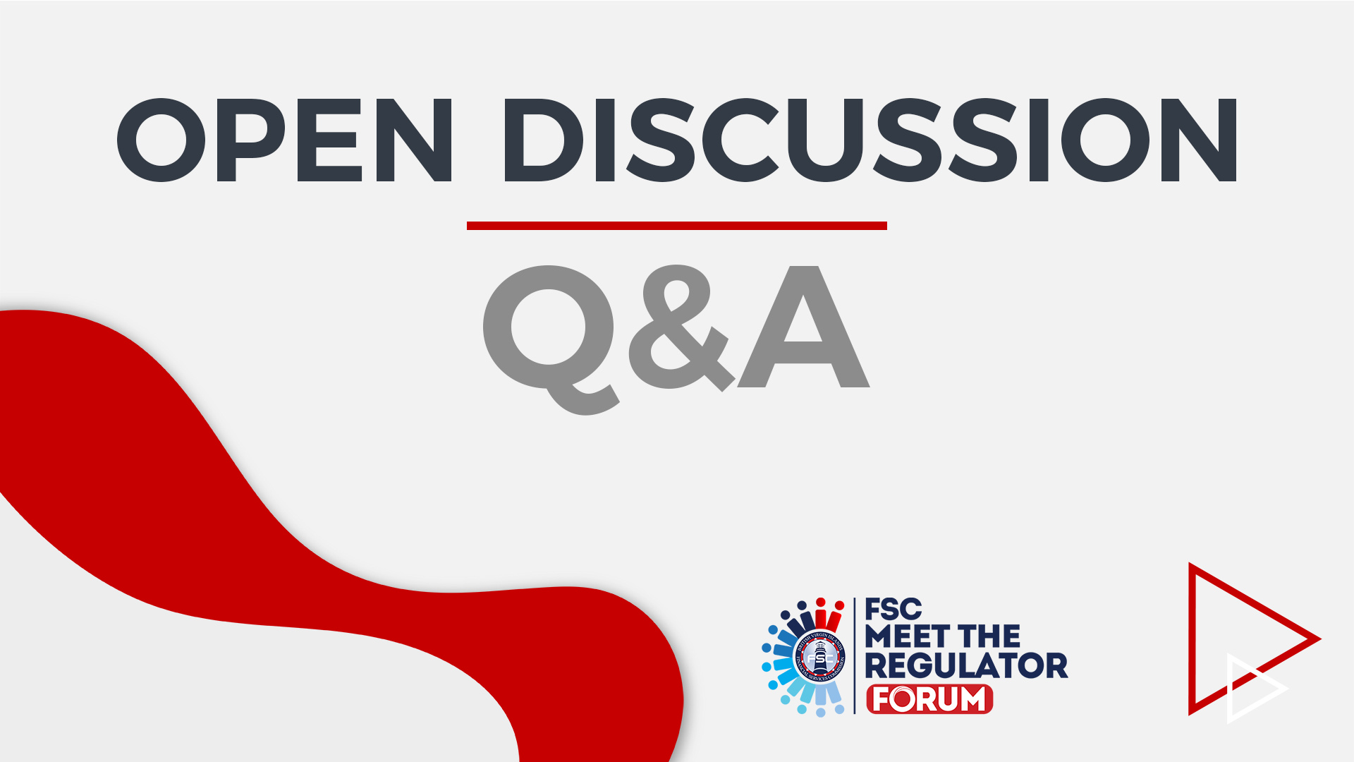

Slide 49


Slide 50


